Slide 1

TYPES Of ML
--- Mounika Voriganti

Slide 2
Feature :
In machine learning, features are individual independent variables that act like a input in your system. Actually, while making the predictions, models use such features to make the predictions.
Label :
The output you get from your model after training it is called a label.

Slide 3
Training Dataset :
Training data sets are sets on which you train your machine i.e algorithm to form relationships between variables.
Testing Dataset :
Testing data set helps you to validate that the training has happened efficiently in terms of either accuracy, or precision so on.

Slide 4
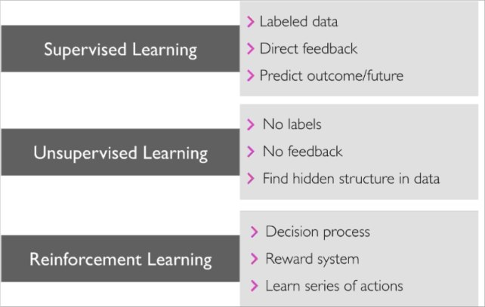
Types

Slide 5
Difference between supervised Learning and unsupervised learning.
Supervised Learning | Unsupervised Learning
Supervised learning algorithms are trained using labeled data. | Unsupervised learning algorithms are trained using unlabeled data.
Supervised learning model takes direct feedback to check if it is predicting correct output or not. | Unsupervised learning model does not take any feedback.
Supervised learning model predicts the output. | Unsupervised learning model finds the hidden patterns in data.
In supervised learning, input data is provided to the model along with the output. | In unsupervised learning, only input data is provided to the model.
The goal of supervised learning is to train the model so that it can predict the output when it is given new data. | The goal of unsupervised learning is to find the hidden patterns and useful insights from the unknown dataset.
Supervised learning needs supervision to train the model. | Unsupervised learning does not need any supervision to train the model.
Supervised learning can be categorized in Classification and Regression problems. | Unsupervised Learning can be classified in Clustering and Associations problems.

Slide 6
Types of supervised learning
Regression Types:
Linear Regression
Polynomial Regression
Support Vector Machine
Decision Tree
Random Forest Regression
K nearest neighbor (KNN)
Classification Types:
Support Vector Machine (SVM)
2. Decision Trees
3. Logistic Regression
4. Naive Bayes
5. Random Forests
6. K nearest neighbor (KNN)

Slide 7
Clustering
A way of grouping the data points into different clusters, consisting of similar data points. The objects with the possible similarities remain in a group that has less or no similarities with another group.
It does it by finding some similar patterns in the unlabelled dataset such as shape, size, color, behavior, etc., and divides them as per the presence and absence of those similar patterns.
Clustering is somewhere similar to the classification algorithm, but the difference is the type of dataset that we are using. In classification, we work with the labeled data set, whereas in clustering, we work with the unlabelled dataset.

Slide 8
Reinforcement Learning
It is a type of machine learning technique that enables an agent to learn in an interactive environment by trial and error using feedback from its own actions and experiences.

